Slide 1
Java Swing
Prepared By: Dimple Bohra

Slide 2
What is Swing in JAVA?
Java Swing is a part of Java Foundation Classes (JFC) that is used to create window-based applications.
It is built on the top of AWT (Abstract Windowing Toolkit) API and entirely written in java.

Slide 3
What is Swing in JAVA?
Unlike AWT, Java Swing provides platform-independent and lightweight components.
The javax.swing package provides classes for java swing API such as JButton, JTextField, JTextArea, JRadioButton, JCheckbox, JMenu, JColorChooser etc.

Slide 4
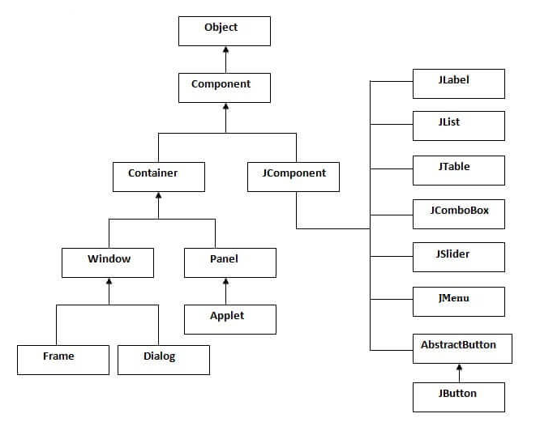
JAVA Swing class hierarchy
Notes:
All components in Java Swing are JComponent which can be added to container classes.

Slide 5
Java Swing Containers
Top level Containers
It inherits Component and Container of AWT.
It cannot be contained within other containers.
Heavyweight.
Example: JFrame, JDialog, JApplet

Slide 6
Java Swing Containers
Lightweight Containers
It inherits JComponent class.
It is a general purpose container.
It can be used to organize related components together.
Example: JPanel

Slide 7
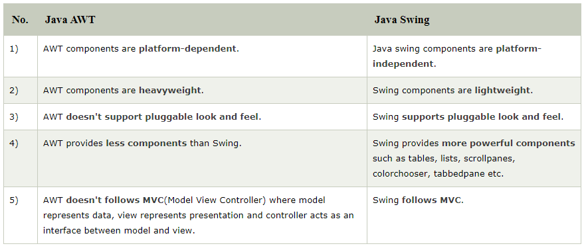
Difference between AWT and Swing

Slide 8
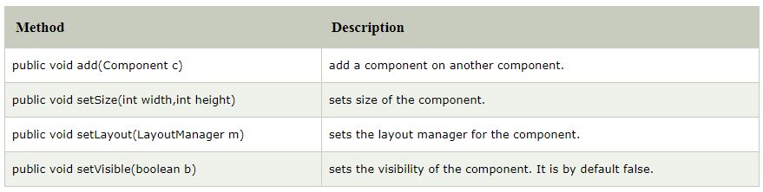
Commonly used methods of component class

Slide 9
How to create frame?
There are two ways to create a frame:
By creating the object of Frame class (association)
By extending Frame class (inheritance)

Slide 10
import javax.swing.*;
public class FirstSwingExample {
public static void main(String[] args) {
JFrame f=new JFrame();//creating instance of JFrame
JButton b=new JButton("click");//creating instance of JButton
b.setBounds(130,100,100, 40);//x axis, y axis, width, height
f.add(b);//adding button in JFrame
f.setSize(400,500);//400 width and 500 height
f.setLayout(null);//using no layout managers
f.setVisible(true);//making the frame visible
}
}

Slide 11
import javax.swing.*;
public class Simple2 extends JFrame{//inheriting JFrame
JFrame f;
Simple2(){
JButton b=new JButton("click");//create button
b.setBounds(130,100,100, 40);
add(b);//adding button on frame
setSize(400,500);
setLayout(null);
setVisible(true);
}
public static void main(String[] args) {
new Simple2();
}}

Slide 12
Swing features
Light Weight − Swing components are independent of native Operating System's API as Swing API controls are rendered mostly using pure JAVA code instead of underlying operating system calls.
Rich Controls − Swing provides a rich set of advanced controls like Tree, TabbedPane, slider, colorpicker, and table controls.
Highly Customizable − Swing controls can be customized in a very easy way as visual appearance is independent of internal representation.
Pluggable look-and-feel − SWING based GUI Application look and feel can be changed at run-time, based on available values.

